Slide 1
Cloud Operations Security
Server & Cloud Security
6

Slide 2
Objectives
Security Operations Functions
Importance of logging and monitoring
Capture and collect
Monitor and report
Best practices for logging and monitoring
Additional AWS services for logging and monitoring
Identifying an incident

Slide 3
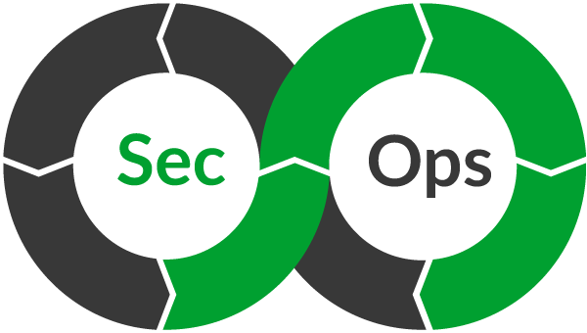
Security Operations Functions

Slide 4
Security Operations (SecOps) Functions
The main objective of a cloud security operations (SecOps) function is to detect, respond to, and recover from active attacks on enterprise assets.
As SecOps matures, security operations should:
Reactively respond to attacks detected by tools
Proactively hunt for attacks that slipped past reactive detections

Slide 5
Importance of logging and monitoring
Logging and Monitoring
Notes:
This section covers the importance of logging and monitoring.

Slide 6
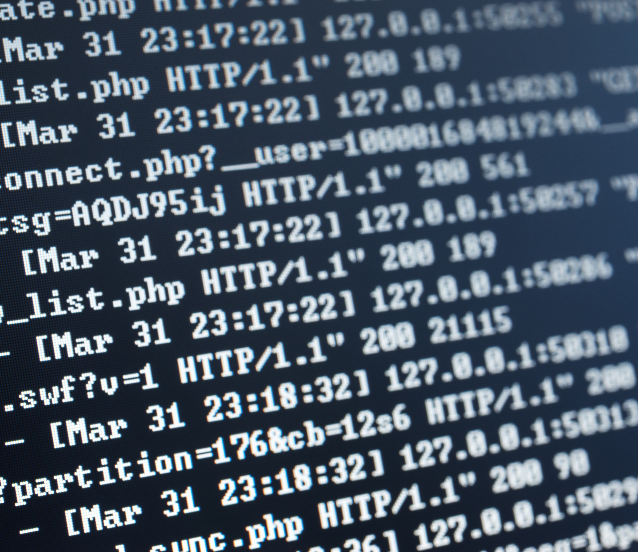
What is logging?
Logging is the collection and recording of activity and event data.
Provided by the service itself
Provided by a secondary service
Information logged will vary based on the service conducting the logging.
Common log elements:
Date and time of event
Origin of event
Identity of resources accessed
Notes:
Logging is the collection and recording of activity and event data. The service itself can provide logging capabilities, as with Amazon Virtual Private Cloud (Amazon VPC) Flow Logs and Amazon Simple Storage Service (Amazon S3) server access logs. Or a secondary service, such as AWS CloudTrail, might provide logging.
The type of information logged will vary based on the service that is conducting the logging, but some common elements are logged:
Date and time of event
Originating location of request
Identity of resources accessed

Slide 7

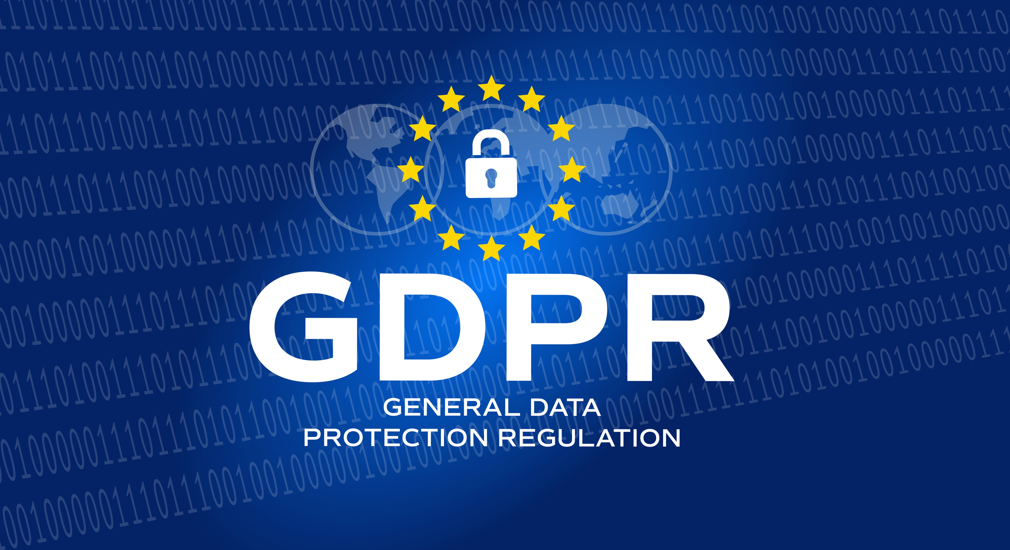
Why is logging important?
Logging provides a record of events, which is useful for the following:
Troubleshooting
Auditing
Recordkeeping
Incident response and remediation
Logs are a requirement for demonstrating compliance with regulations, such as the following:
HIPAA
GDPR
LGPD
Notes:
A comprehensive logging methodology can help you in every phase of your incident response strategy. Log files are also a primary focus point in incident response. This is because of their ability to provide detailed, time-stamped records to investigators and incident responders. Logging provides a record of events captured at a specific point in time. Common log files include access logs, application logs, system logs, event logs, API call logs, and database logs.
Log files can assist in troubleshooting performance issues within your AWS Cloud and on-premises environment. Logs are also necessary to perform security audits and adhere to recordkeeping requirements to demonstrate compliance with a number of regulatory measures. Examples of regulatory measures include the Health Insurance Portability and Accountability Act (HIPAA) in the United States, the European Union General Data Protection Regulation (GDPR), and Brazil's General Data Protection Law (LGPD). Finally, log files can assist you to remediate issues that arise organically or through audits. Logs provide you with insights on the point in time when an issue arose.

Slide 8

What is monitoring?
Monitoring is the continuous verification of the security and performance of your resources, applications, and data.
AWS provides several services that give you the visibility to spot issues before they impact operations:
AWS CloudTrail
Amazon CloudWatch
Amazon EventBridge
AWS X-Ray
Notes:
Monitoring is the practice of continuously verifying the security and performance of your resources and data. AWS provides several services that you can use to monitor your resources, but this module will focus on two: AWS CloudTrail and Amazon CloudWatch.
CloudTrail provides a record of actions taken within your environment. CloudTrail logs include information such as the action type, identity of the user, and time and date of the action. With this information, you can monitor who is doing what and when they are doing it.
With CloudWatch, you can monitor your resources and applications in real time. CloudWatch provides you with system-wide visibility into resource utilization, application performance, and operational health.
Monitoring services and tools, along with a solid incident response plan, can help you mitigate the effects of a system outage or malicious actor. In many cases, monitoring can help you to spot an issue before it has operational impact.

Slide 9
Key takeaways: Importance of logging and monitoring
Logging is the collection and recording of activity and event data.
Monitoring is the continuous verification of the security and performance of your resources, applications, and data.
AWS provides several services that you can use to log and monitor your resources.
Notes:
Key takeaways from this section of the module include the following:
Logging is the collection and recording of activity and event data.
Monitoring is the continuous verification of the security and performance of your resources, applications, and data.
AWS provides several services that you can use to log and monitor your resources.

Slide 10
Capture and collect
Logging and Monitoring
Notes:
This section covers how to capture and collect logs.

Slide 11
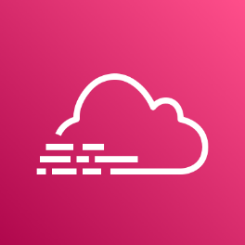
AWS CloudTrail
Assists you to enable governance and compliance, as well as operational and risk auditing of your AWS account
Records actions taken by a user, role, or AWS service as events
Provides visibility of events in the CloudTrail console
Can be used to view, search, download, archive, analyze, and respond to account activity across your AWS infrastructure
AWS CloudTrail
Notes:
AWS CloudTrail is an AWS service that helps you enable governance and compliance, as well as operational and risk auditing of your AWS account. Actions taken by a user, role, or an AWS service are recorded as events in CloudTrail. Events include actions taken in the AWS Management Console, AWS Command Line Interface (AWS CLI), and AWS Software Development Kits (SDKs) and APIs. You can view, search, download, archive, analyze, and respond to these recorded events in the CloudTrail console.
You can integrate CloudTrail into applications by using the API, automate trail creation for your organization, check the status of trails you create, and control how users view CloudTrail events.
For more information, see AWS CloudTrail at https://aws.amazon.com/cloudtrail.

Slide 12
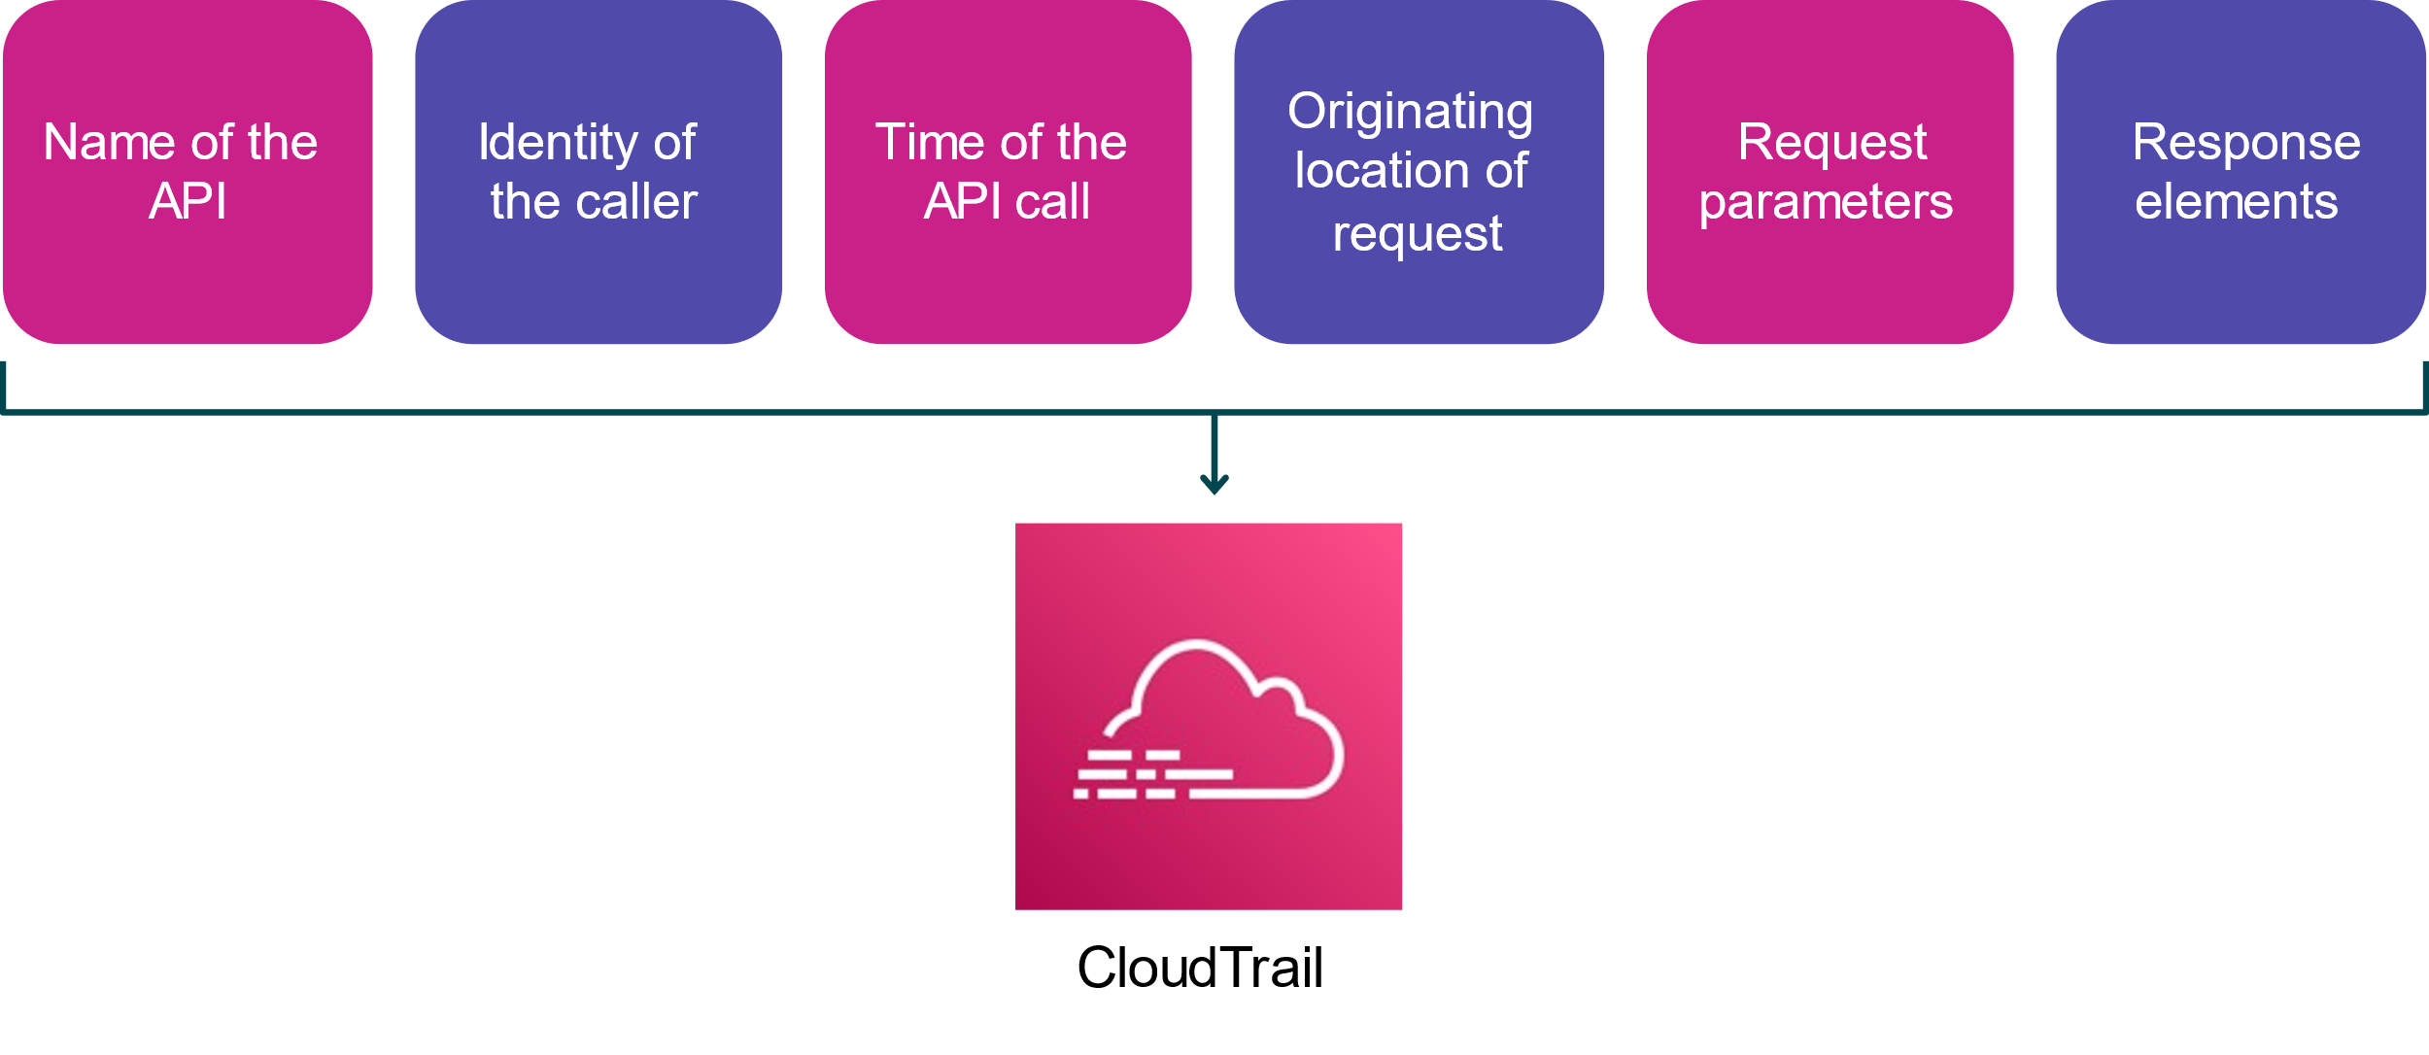
API security-relevant information
Notes:
CloudTrail records important information about each API call. Information includes the name of the API, identity of the caller, time of the API call (captured in Universal Time Coordinated, or UTC), location that the call originated from, request parameters, and response elements returned by the AWS service. This information helps you to track changes made to your AWS resources, troubleshoot operational issues, and ensure compliance with internal policies and regulatory standards.
You can use the AWS API call history that CloudTrail produces to track changes to AWS resources. Changes include creation, modification, and deletion of AWS resources, such as Amazon Elastic Compute Cloud (Amazon EC2) instances and Amazon VPC security groups. The log file record example on the next few slides shows actions from an AWS Identity and Access Management (IAM) user named Jane. Jane used the ec2-stop-instances command in the AWS CLI to call the Amazon EC2 StopInstances action.

Slide 13
Monitor and report
Logging and Monitoring
Notes:
This section covers monitoring and reporting.

Slide 14

Amazon CloudWatch
Is a monitoring and observability service
Provides a unified view of the operational health of your AWS resources, applications, and services
Collects metrics in the AWS Cloud and on premises
Can be used for infrastructure monitoring and troubleshooting
Provides the ability to customize logs and events
Amazon CloudWatch
Notes:
Amazon CloudWatch is a monitoring and observability service built for DevOps engineers, developers, site reliability engineers (SREs), IT managers, and product owners. CloudWatch collects monitoring and operational data as logs, metrics, and events. This information gives you a unified view of your AWS resources, applications, and services that run on AWS and on-premises servers. You can use CloudWatch to detect anomalous behavior in your environments, set alarms, visualize logs and metrics side by side, take automated actions, troubleshoot issues, and discover insights to keep your applications running smoothly. With CloudWatch, you can collect, access, and correlate information from all your AWS resources, applications, and services running on AWS and on premises. This capability helps you break down data silos to gain system-wide visibility and quickly resolve issues.
You can use CloudWatch Events to deliver a near-real-time stream of system events that describe changes in AWS resources. CloudWatch Events becomes aware of operational changes as they occur and responds to them. CloudWatch Events takes corrective action as necessary by sending messages to respond to the environment, activating functions, making changes, and capturing state information. CloudWatch Events is currently being replaced by Amazon EventBridge.
With CloudWatch Logs, you can monitor, store, and access your log files from EC2 instances, CloudTrail, Amazon Route 53, and other sources. You can centralize the logs from all of your systems, applications, and AWS services in a single, highly scalable service. You can then easily view the logs, search them for specific error codes or patterns, filter them based on specific fields, or archive them securely for future analysis. With CloudWatch Logs, you can see all of your logs, regardless of their source, as a single and consistent flow of events ordered by time. You can query the logs and sort them based on other dimensions, group them by specific fields, create custom computations with a powerful query language, and visualize log data in dashboards.
For more information, see Amazon CloudWatch at https://aws.amazon.com/cloudwatch.

Slide 15
Comparing CloudTrail and CloudWatch
AWS CloudTrail | Amazon CloudWatch
Continuously monitors and logs user activities | Continuously monitors resource and application performance
Useful for compliance auditing, security analysis, and troubleshooting | Useful for detecting anomalous service behavior, setting alarms, and discovering insights
Helps you determine WHO performed WHAT unauthorized action and WHEN they did it | Alerts you that an issue has occurred due to an unauthorized action
When used together, you can create custom CloudWatch dashboards, alarms, and notifications for key metrics and specific CloudTrail events.
Notes:
The AWS CloudTrail service provides the ability to continuously monitor and log the activity of users, groups, and roles within your AWS environment. These log files are useful for compliance auditing, security analysis, and troubleshooting. Assume that an EC2 instance was deleted without permission. CloudTrail could provide a log that gives you the identity of the user, group, or role that performed the unauthorized action.
Amazon CloudWatch provides the ability to continuously monitor the performance of your AWS resources and applications. CloudWatch can help detect and notify you of anomalous service behavior, such as an EC2 instance deletion. Whether coupled with CloudTrail or on its own, CloudWatch provides you with increased oversight of your AWS environment.
When used together, you can create custom CloudWatch alarms and notifications for specific CloudTrail events. This helps you to respond quickly to key operational issues.

Slide 16
Key takeaways: Monitor and report
CloudWatch provides a unified view of the operational health of your AWS resources, applications, and services.
CloudWatch collects monitoring and operational data as logs, metrics, and events.
CloudTrail monitors actions, and CloudWatch monitors performance.
Create custom dashboards, alarms, and notifications for key metrics.
Notes:
Key takeaways from this section of the module include the following:
CloudWatch provides a unified view of the operational health of your AWS resources, applications, and services.
CloudWatch collects monitoring and operational data as logs, metrics, and events.
CloudTrail monitors actions, and CloudWatch monitors performance.
Create custom dashboards, alarms, and notifications for key metrics.

Slide 17
Best practices for logging and monitoring
Logging and Monitoring
Notes:
This section describes best practices for logging and monitoring.

Slide 18

Best practices for logging and monitoring
Define your organizational requirements for logs, alerts, and metrics.
Configure service and application logging throughout your workload.
Analyze your logs centrally.
Notes:
The first step to use the logging and monitoring capabilities that AWS provides is to define your requirements. Identify the resources, applications, and services that you want to maintain logs for. Logging and monitoring requirements can vary widely, so you must determine what the organizational, legal, and compliance requirements for your workloads are. Then, evaluate and identify the resources that AWS has available to assist.
When you collect metrics and define baselines, you can gain insights to potential security threats. Define who should receive alerts and what they should do with the alerts that they receive. Configure logging throughout the workload, including application logs, AWS services logs, and resource logs.
Collect your logs centrally. Use automation from services such as CloudWatch to analyze logs to detect any anomalies or indicators of malicious activity or compromise.

Slide 19
Incident recognition and response
Is a set of information security policies and procedures that you can use to identify, contain, and eliminate cyberattacks
Enables an organization to quickly detect and halt attacks
Helps you to minimize damage and prevent future attacks
Notes:
Incident response is a set of information security policies and procedures that you can use to identify, contain, and eliminate cyberattacks.
The goal of incident response is to enable an organization to quickly detect and halt attacks, which helps to minimize damage and prevent future attacks of the same type.

Slide 20
Recognizing incidents
Not all events are incidents in need of immediate remedy.
Logging in from a remote location
Failing hard drive that is still fully operational
Employee trying to access resources that they shouldn't access
Notes:
How would an enterprise know if abuse was taking place? How would they differentiate between abnormal events that need their attention, and incidents that need immediate analysis and remediation?
Not all events are incidents in need of immediate remedy. Let’s take a look at a few examples of such events:
Logging in from a remote location: An employee might be traveling or using an approved virtual private network (VPN).
Failing hard drive that is still fully operational: Knowing this information allows an enterprise to timely schedule a cycling of the drives without panicking and hot swapping when it's too late and has already failed. Hot swapping is the act of removing components from or plugging them into a computer system while the power remains switched on.
Employee trying to access resources that they shouldn't access: Although this might not constitute a breach if the access was denied, it's still a behavioral insight that you should monitor.

Slide 21
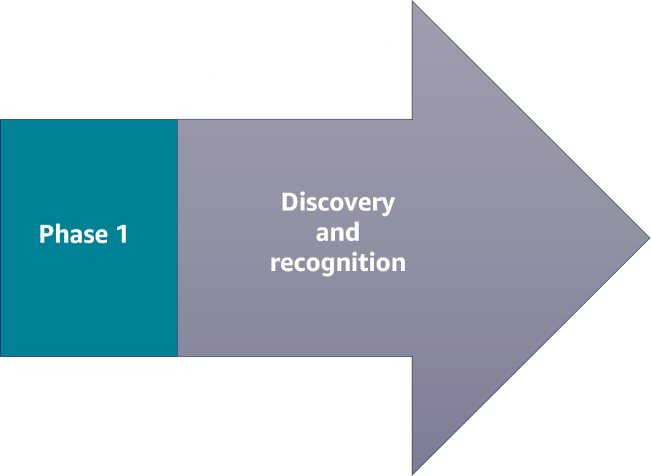
Phase 1: Discovery and recognition
Incident identification, logging, and categorization
Incident notification and escalation
Investigation and diagnosis
Notes:
Incident response has two phases. The first phase is the discovery and recognition phase. Here is where incident identification, logging, and categorization of the incident takes place. Once an incident is identified through user reports, solution analyses, or manual identification, the incident is logged and an investigation and categorization can begin.
During this phase, a notification is received. Notifications are set up by the user and initiated by specified alerts to send an email, SMS text, or push notification through a mobile app. Incident escalation is what happens when an employee can’t resolve an incident themselves and needs to hand off the task to a more experienced or specialized employee.
Investigation and diagnosis includes conducting an incident investigation to gather answers and develop strategies to resolve any threats.
AWS offers a range of services and products that help companies discover and identify events that could lead to, or have already become, an incident.

Slide 22
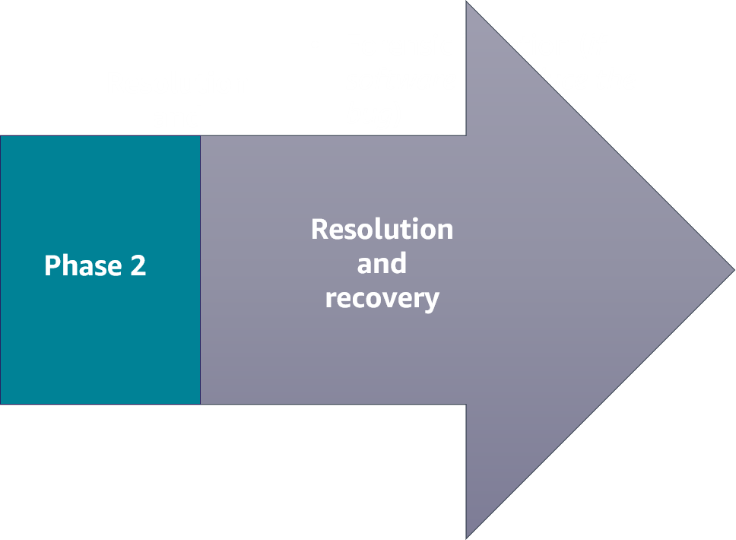
Phase 2: Resolution and recovery
Forensic isolation (if software, reproduce the bug)
Stage a fix
Deploy the fix
Incident closure
Automate theses processes wherever possible, and run game days in staging (safe) environments to fine-tune your corporate-wide incident response process.
Notes:
When an enterprise has identified the failure of a component, a reduction in quality of service, or an exploit in need of remedy, they move into the resolution and recovery phase of incident response.
This second phase consists of the following:
Forensic isolation: Isolate the incident, and perform a deep dive to discover the issue. Forensics often requires capturing the disk image or as-is configuration of an operating system. The problem might be a bug in the code base. If so, then you need to reproduce the error. Without being able to reproduce the error that the customer experienced, you won't be able to fix it.
Staging a fix: Reproduce the issue, apply a fix, and test.
Deploying the fix: Push any new infrastructure, as code, or any new application code to production.
Incident closure: Resolve the incident.
AWS offers a range of services and products that help companies remediate an incident.

Slide 23
Key takeaways: Identifying an incident
Incident response is a set of information security policies and procedures that you can use to identify, contain, and eliminate cyberattacks.
Not all events are incidents in need of immediate remedy.
The first phase of an incident is the discovery and recognition phase.
The second phase of an incident is the resolution and recovery phase.
Notes:
Key takeaways from this section of the module include the following:
Incident response is a set of information security policies and procedures that you can use to identify, contain, and eliminate cyberattacks.
Not all events are incidents in need of immediate remedy.
The first phase of an incident is the discovery and recognition phase.
The second phase of an incident is the resolution and recovery phase.

Slide 24
Objectives
Security Operations Functions
Importance of logging and monitoring
Capture and collect
Monitor and report
Best practices for logging and monitoring
Additional AWS services for logging and monitoring
Identifying an incident

